Slide 1

Prostate Cancer
Kundaria Cancer Prevention Foundation
Division of Rajkot Cancer Society
Since January 2019

Slide 2
Prostate Cancer
Prostate cancer is one of the most common types of cancer in men.
Indian Data : Globocan, 2018.
New cases: 25,696
Deaths: 17,184
The incidence rates of this cancer are constantly and rapidly increasing in India. The cancer projection data shows that the number of cases will become doubled by 2020.
Prostate cancer that is detected early — when it’s still confined to the prostate gland — has a better chance of successful treatment.

Slide 3
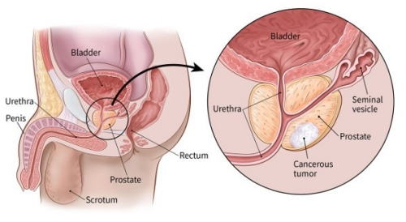
Anatomy of Prostate Gland

Slide 4
The prostate is a small walnut shaped gland, found only in males. It makes some of the fluid that is part of semen.
The size of the prostate can change as a man ages. In younger men, it is about the size of a walnut, but it can be much larger in older men.
Prostate cancer begins when cells in the prostate gland start to grow out of control.
Usually prostate cancer grows slowly and is initially confined to the prostate gland, where it may not cause serious harm. However, other types are aggressive and can spread quickly.

Slide 5

Symptoms
Prostate cancer may cause no signs or symptoms in its early stages.
Prostate cancer that's more advanced may cause signs and symptoms such as:
Frequent urinating
Trouble urinating, pain, burning, or weak urine flow
Blood in the urine (Hematuria)
Painful ejaculation

Slide 6



Pain in the lower back, hips or upper thighs
Dull pain in the lower pelvic area
Bone pain
Loss of appetite
Loss of weight

Slide 7


Risk Factors
Age
Increases after the age of 50,
Rare before the age of 45
Race or Ethnicity:
More common in black males than white,
Asian males have a lower risk than black males or white males

Slide 8

Family History:
History of prostate cancer, increases the chance of developing cancer
Genetic Factors:
Inherited features, including changes to the BRCA1 and BRCA2 genes, may increase the risk.
Men born with Lynch syndrome also have a higher risk of prostate and other cancers

Slide 9


Other Possible Risk Factors
Diet
Obesity
Smoking
Exposure to chemicals
Inflammation of the prostate
Sexually transmitted infection
Vasectomy

Slide 10


How can it be prevented?
Maintain healthy body weight and avoid obesity
Indulge in regular physical activity

Slide 11





• Eat vegetables and fruits everyday
Choose whole grains instead of refined grain products
Limit the intake of dairy foods and diets rich in calcium
Limited intake of high-calorie foods and drinks
Avoid alcohol

Slide 12
Early detection/Screening
DRE (Digital rectal examination)
PSA (Prostate-specific antigen )

Slide 13
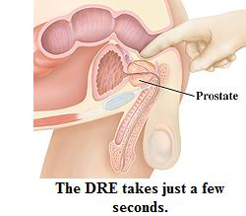
Digital Rectal Exam (DRE)
DRE is less effective than the PSA blood test in finding prostate cancer, but it can sometimes find cancers in men with normal PSA levels.
For this reason, it might be included as a part of prostate cancer screening.

Slide 14
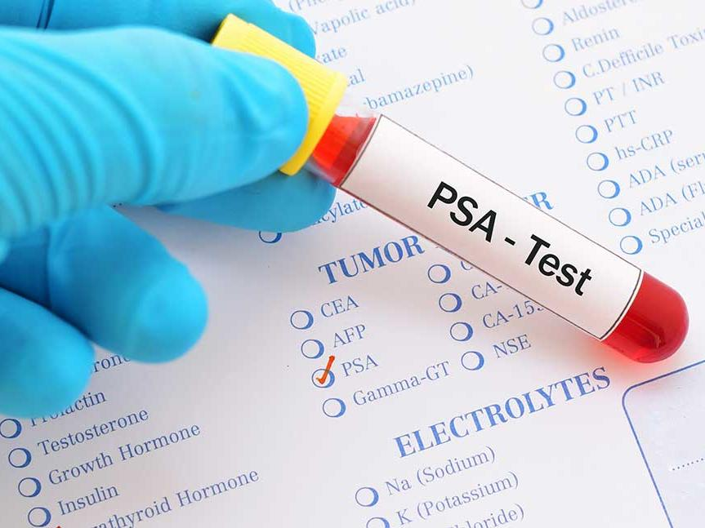
Prostate-Specific Antigen (PSA) blood test
Prostate-specific antigen (PSA) is a protein made by cells in the prostate gland (both normal cells and cancer cells).
The chance of having prostate cancer goes up as the PSA level goes up
If your PSA level is high, you might need further tests to look for prostate cancer
The American Urology Association recommend screening at 40 years for African American males and those with family history of cancers, and at 55 years for others.

Slide 15
Outlook
Males with early stage prostate cancer have a good chance of effective treatment and survival.
Localized or regional cancer: Nearly 100% will survive at least another 5 years.
Distant: Around 30% will survive at least 5 more years if the cancer has affected other parts of the body.
With treatment, the overall 5 year survival rate for prostate cancer is 98%. Many people live longer than this, however.
The best way to detect prostate cancer in the early stages is to attend regular screening.

