Slide 1
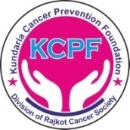
Oral Cancer
Kundaria Cancer Prevention Foundation
Division of Rajkot Cancer Society
Since January 2019

Slide 2
Oral Cancer
India has one third of oral cancer cases in the world.
Oral cancers in India estimated (Globocan, 2018) :
New cases: 1,19,992
Deaths: 72,616
Oral cancer accounts for around 30% of all cancers in India, occurring most often in people over 40 years old. Oral cancers are most often discovered after they’ve spread to the lymph nodes of the neck.
More men suffer and die from oral cancer than women.
Early detection is key to surviving oral cancer.

Slide 3
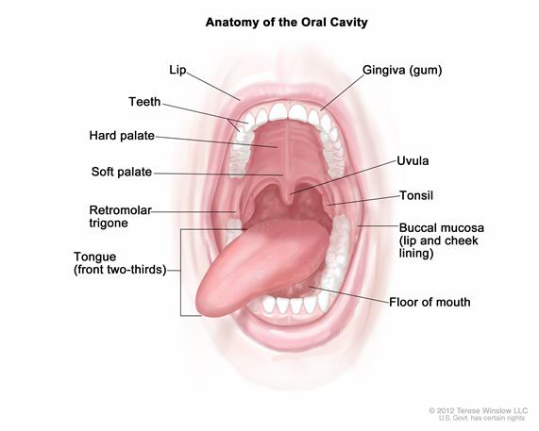
Oral Cancer
Oral cancer is cancer that develops in the tissues of the mouth or throat. It belongs to a larger group of cancers called head and neck cancers.
Types of oral cancers :
Oral cancers include cancers of the:
Lips
Tongue
Inner lining of the cheek
Gums
Floor of the mouth
Hard and soft palate

Slide 4



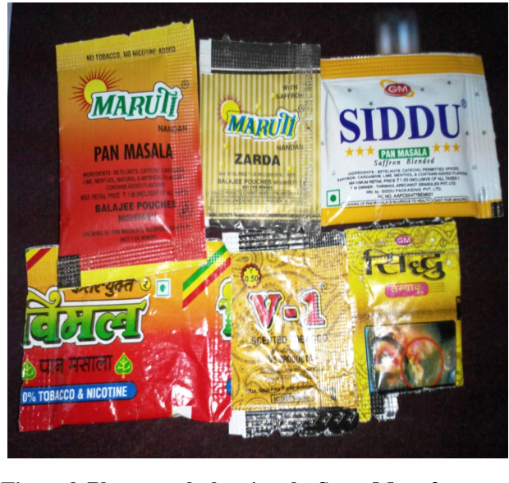
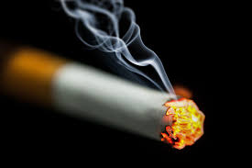
Risk Factors
Tobacco use of any kind, including cigarettes, cigars, pipes,
chewing tobacco and snuff
Smokers are six times more likely than nonsmokers to develop oral cancers
Smokeless tobacco products are 50 times more likely to develop oral cancers

Slide 5

Excessive consumption of alcohol
Oral cancers are about six times more common in drinkers than in nondrinkers.
People who consume large amounts of alcohol and tobacco are at an even greater risk, especially when both products are used on a regular basis.

Slide 6


Other Risk Factors
Family history of oral or other types of cancer
Excessive sun exposure

Slide 7
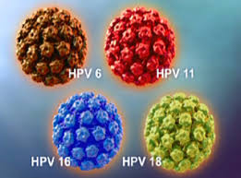
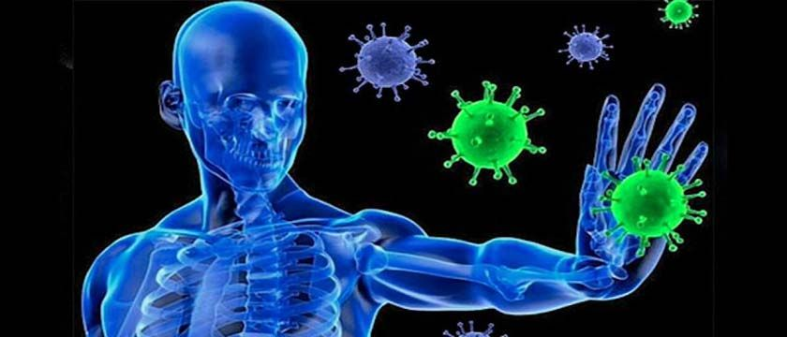

Human Papilloma Virus (HPV)
Weak immune system
Poor Nutrition

Slide 8
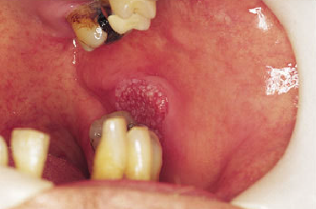
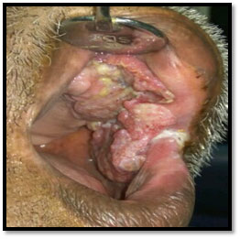
Symptoms
In the early stages, there are often no signs or symptoms of oral cancer.
A lip or mouth sore that doesn't heal
Loose teeth
Mouth pain
Growth or lump inside your mouth
Ear pain

Slide 9
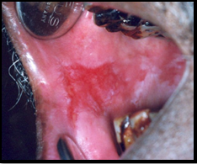
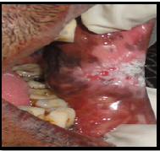
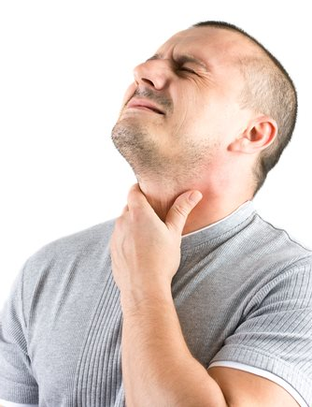
White or reddish patch on the inside of your mouth
Difficult or painful swallowing
Hoarseness, chronic sore throat, or change in voice
Unexplained bleeding in the mouth
Weight loss

Slide 10
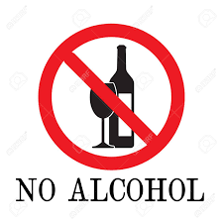
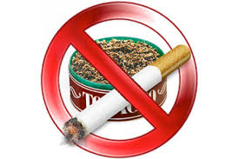

Prevention
There's no proven way to prevent mouth cancer.
However, you can reduce your risk of mouth cancer if you:
Avoid excessive sun exposure

Slide 11
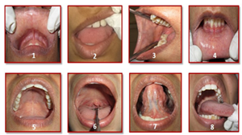
Early Detection
Oral visual self examination
See your dentist regularly - Biannual dental checkups

Slide 12
Outlook
The outlook for oral cancers depends on
Type and stage of cancer
General health
Age
Response to treatment
60% of all people with oral cancer will survive for five years or more. The earlier the stage at diagnosis, the higher the chance of survival after treatment. Thus timely diagnosis and treatment are most important.

