Slide 1

Lung Cancer
Kundaria Cancer Prevention Foundation
Division of Rajkot Cancer Society

Slide 2
Lung Cancer
Lung cancer is a type of cancer that begins in the lungs. Lung cancer is the most common cancer in men and women across the world.
Lung cancer in India ( Globocan 2018)
The mean age for getting lung cancer : 54.6 years. The majority of lung cancer patients are more than 65 years of age.
90% of lung cancer are linked to smoking and exposure to second hand smoke.
 | New Cases | Deaths
Lung cancer (Men) | 48,698 | 45,363
Women | 19,097 | 18,112
Both sexes | 67,795 | 63,475

Slide 3
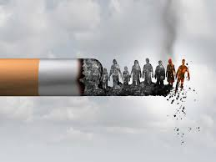
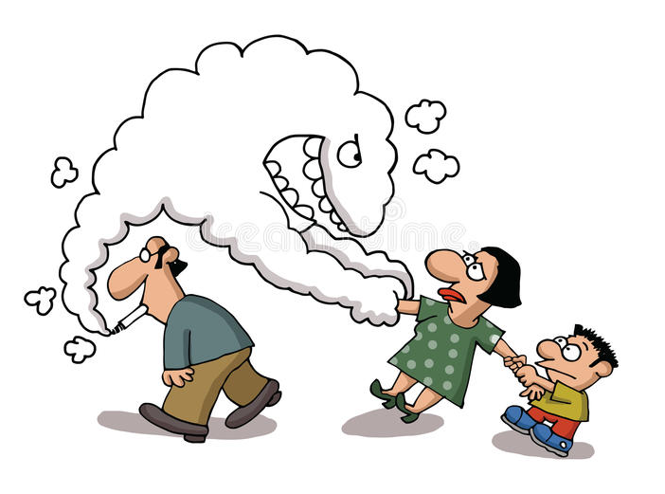
Risk Factors
Smoking (cigarette smokers are 15 to 30 times more likely to get lung cancer than nonsmokers)
Exposure to secondhand smoke

Slide 4
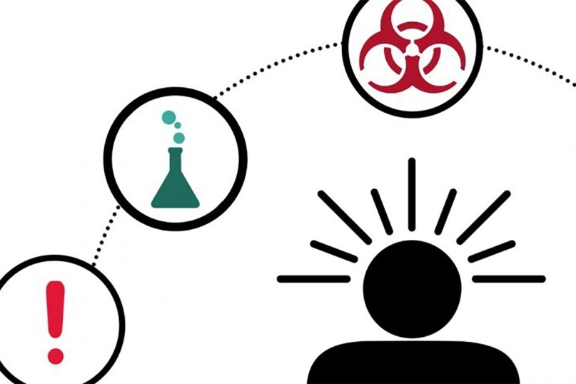

Exposure to radon gas
Exposure to asbestos and other carcinogens
Personal/Family history of lung cancer

Slide 5
Symptoms
Lung cancer typically doesn't cause signs and symptoms in its earliest stages.
Signs and symptoms of lung cancer typically occur only when the disease is advanced.

Slide 6
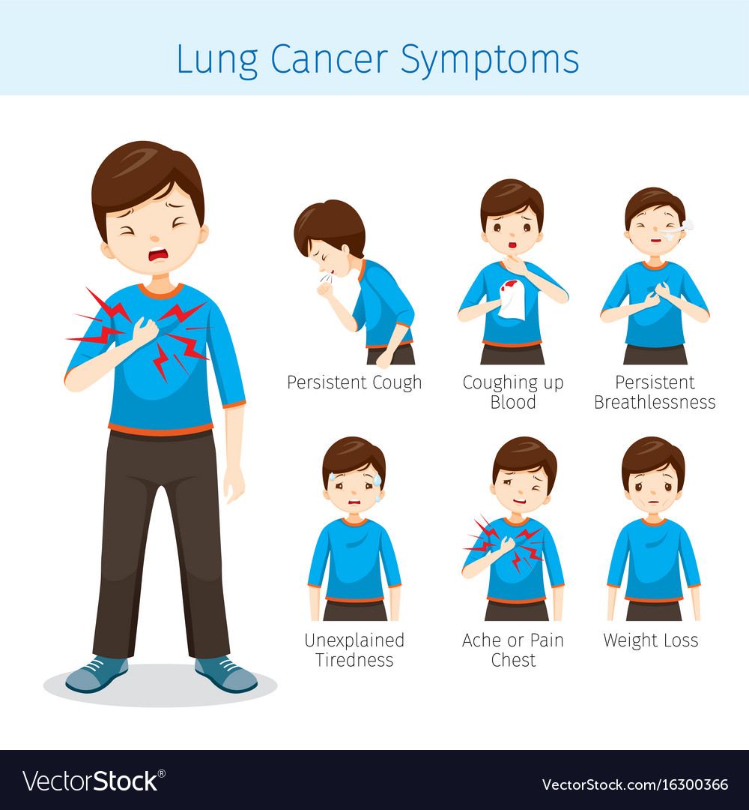

Slide 7
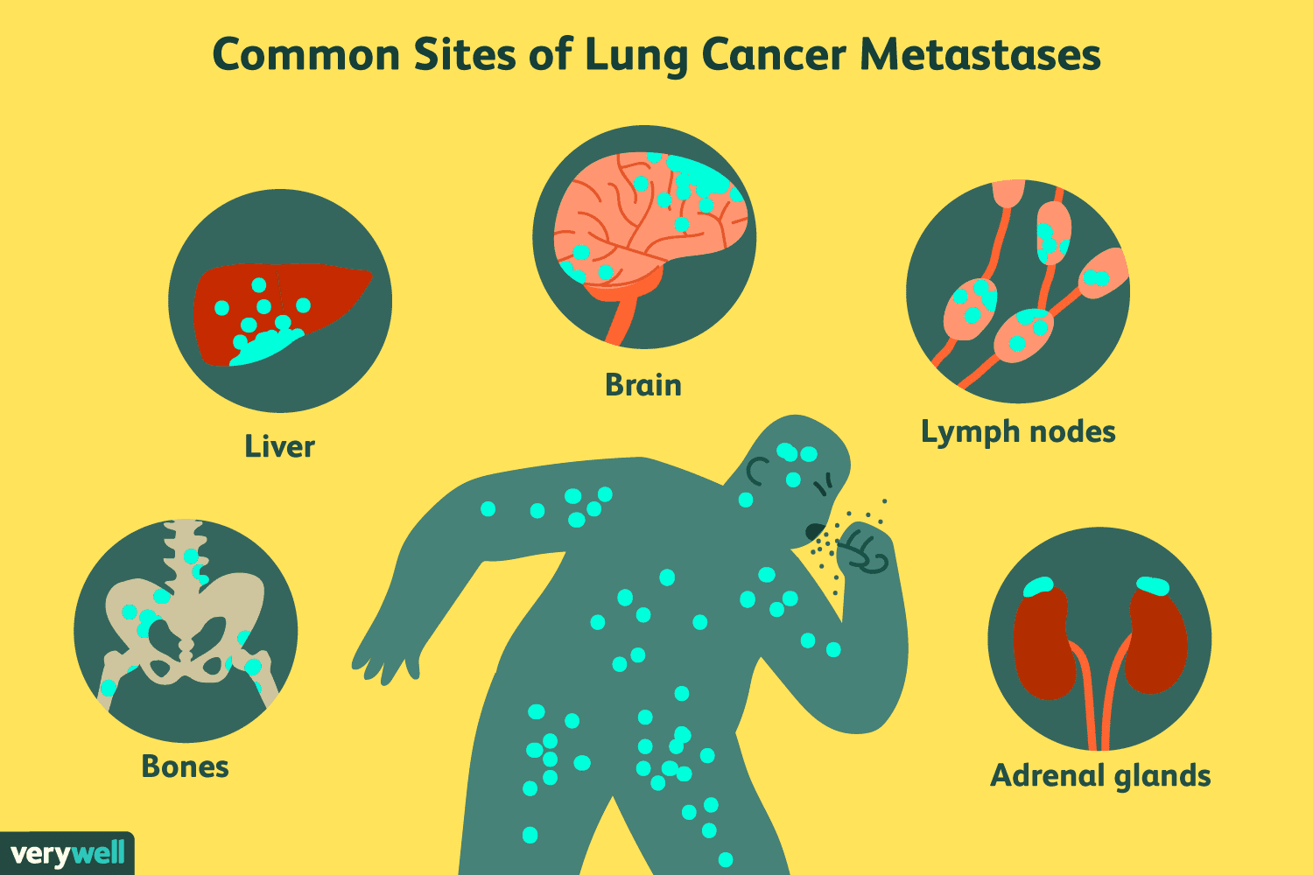
Complications
Cancer Metastasis (spread of cancer to other parts of the body )

Slide 8


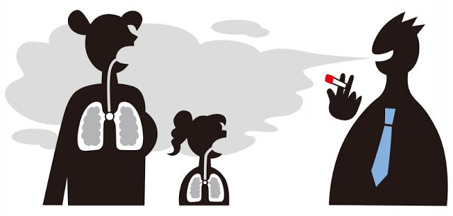
Prevention
Don't smoke
Stop smoking
(quitting can significantly lower that risk)
Avoid secondhand smoke

Slide 9


Lower your exposure to radon
Lower exposure to workplace risk factors
Eat a diet full of fruits and vegetables
Exercise most days of the week.

Slide 10


Screening Tests
Screening tests for lung cancer are :
1. Chest x-ray :
2. Sputum cytology :

Slide 11
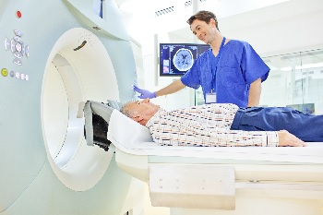
3. Low-dose spiral CT scan (LDCT scan): A procedure that uses low-dose radiation to make a series of very detailed pictures of areas inside the body. It uses an x-ray machine that scans the body in a spiral path. The pictures are made by a computer linked to the x-ray machine. This procedure is also called a low-dose helical CT scan.
Low Dose Computed Tomography (Low Dose CT or LDCT) is better than plain X-ray of the chest at finding small abnormalities in the lungs.
LDCT uses a much lower dose of radiation than a normal chest CT.

Slide 12
Screening Guidelines
As per the guidelines of The American Cancer Society, if you meet all the following criteria, you should go for lung cancer screening :
1. Your age is between 55 and 74 years
2. You have a 30-pack-year smoking history (calculated as number of packs of cigarettes multiplied by the number of years you have been smoking)
3. You are either still smoking or have quit in the last 15 years
4. You are in fairly good health (you should not have symptoms of lung cancer or serious medical problems or metal implants or prior history of lung cancer treated)
Screening is to be done every year till the age of 74 years or till symptoms appear.

Slide 13
Outlook
The outlook is better when treatment begins before cancer spreads outside the lungs. Because early symptoms can be easily overlooked, lung cancer is usually diagnosed in later stages.
The general prognosis of lung cancer is poor because doctors tend not to find the disease until it is at an advanced stage. Five-year survival is around 54% for early stage lung cancer patients that have a tumor localized to the lungs, but only around 4% in those with advanced, inoperable lung cancer.
Smoking cessation is the most important measure that can prevent the development of lung cancer

