Slide 1
Cervical Cancer
Kundaria Cancer Prevention Foundation
Division of Rajkot Cancer Society
Since January,2019

Slide 2
What is cervical cancer?
Cervical cancer is the second most common cancer among Indian women (As per Globocan 2018).
Cervical cancer is a cancer that can be prevented by regular and periodic screening.
In India, an average of 96,922 new cases of cervical cancer are reported.
Cervical cancer accounts for 60,078 deaths in India.

Slide 3
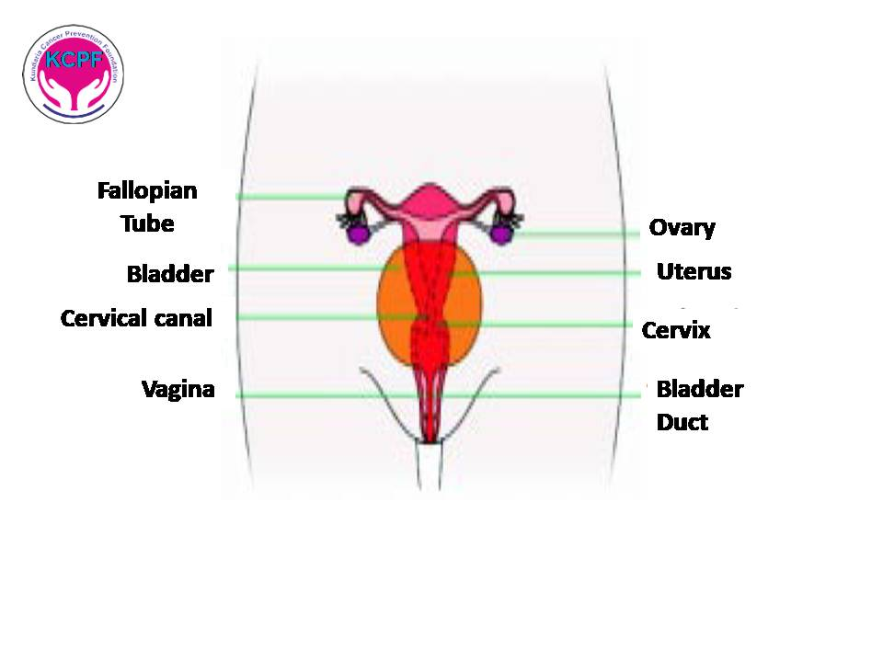

Slide 4
Risk Factors of Cervical Cancer

Slide 5
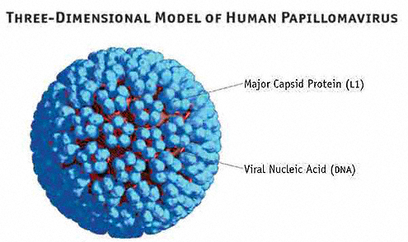

Persistent infection of the cervix with Human Papilloma Virus (HPV)
Having many sexual partners
Having first sexual intercourse at a young age

Slide 6



Becoming a mother at a young age
Giving birth to many children
Smoking

Slide 7


Having other diseases which lower immunity such as HIV/AIDS, immunosuppressive drugs, transplant etc
Hereditary

Slide 8
Symptoms of Cervical Cancer

Slide 9


Unusual or excessive vaginal discharge with foul smell
Abnormal vaginal bleeding: Bleeding and spotting between periods, unusually longer or heavier periods, bleeding after menopause
Vaginal bleeding after having sexual intercourse

Slide 10


Pain in the lower abdomen or pelvic pain
Back pain

Slide 11

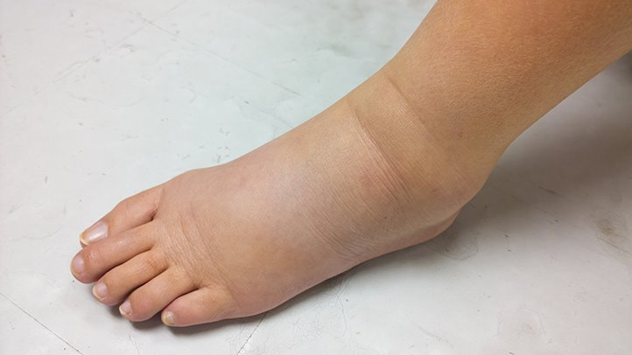
Weight loss
Swelling, pain in the legs

Slide 12
How to prevent Cervical Cancer
Primary Prevention
Secondary Prevention

Slide 13
Primary Prevention
It is designed to prevent the disease from occurring in the first place.

Slide 14
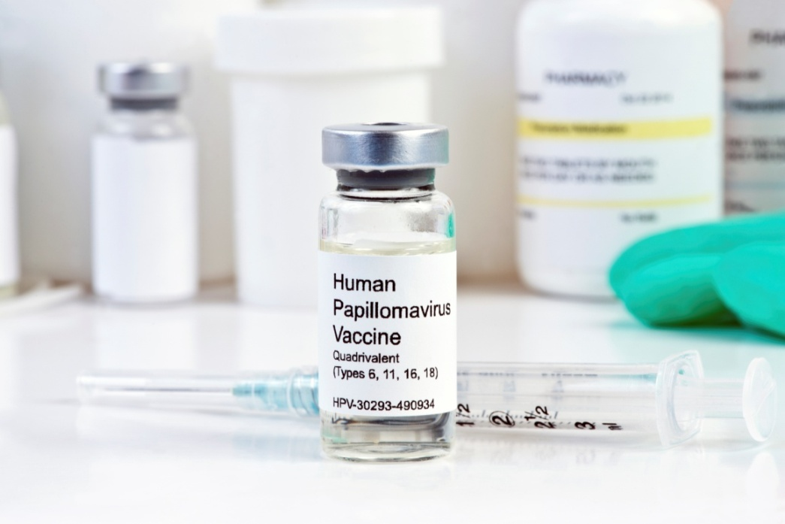

HPV vaccination
HPV vaccination to girls 9-26 years

Slide 15

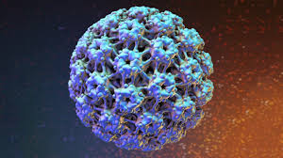
HPV is a sexually transmitted virus. Anyone who is sexually active is likely to be infected with any of the 200 HPV viruses at some point in their lives. Most HPV infections go away on their own, but there is a risk of cancer if the infection persists.
This vaccine must be given before becoming sexually active.

Slide 16

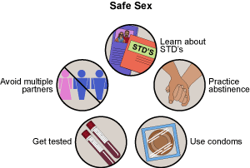
Use condoms to reduce HPV infection
Safe physical intercourse
Avoid relationships with more than one person

Slide 17
Secondary Prevention
Secondary prevention aims at detecting the disease in its early stages (pre-cancers) through screening and to prevent its progression.
Screening tests are done in apparently healthy women to diagnose changes in the cervix which are pre-cancerous and could develop into cervical cancer in future.
PAP test

Slide 18
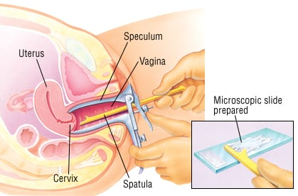
PAP smear test

Slide 19
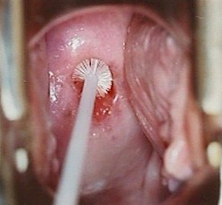

Slide 20
What is a PAP test?
The Pap smear is a simple test that is done to collect a few cells from the cervix and help to diagnose precancerous and cancerous conditions of the cervix. It also aids in diagnosing infections of the lower reproductive tract.
As per the International recommendations, women above the age of 21 years can get the pap test. If you are 30 years and above Pap test should be done once in every 3 years till you turn 65 years of age.
Women who do not routinely require Pap test :
Women aged less than 21 years and above 65 years
Women who had their womb removed for non-cancerous conditions

Slide 21


Slide 22

What is a screening test?
Screening test is a test performed for early diagnosis in a normal person who does not show any signs or symptoms of cancer.
Screening tests do not prevent cancer from occurring, but the cancer can be caught early so that it can be treated before it becomes life-threatening.

Slide 23


What is the screening test for breast cancer?
What is the screening test for cervical cancer?
What is the HPV vaccine?

Slide 24
Thank you

