Slide 1
Breast Cancer
Kundaria Cancer Prevention Foundation
Division of Rajkot Cancer Society

Slide 2
Breast Cancer
Breast cancer is the most common cancer found in Indian women.
In 2018, there were 1,62,468 new cases of breast cancer and 89,090 deaths in India.
Women living in cities have a higher risk of breast cancer than women living in rural areas.

Slide 3
What is breast cancer?
Breast cancer is a malignant tumor that begins in the cells of the breast, which is capable of invading other organs of the body.
Breast cancer can happen to both male and female, but common among females.

Slide 4
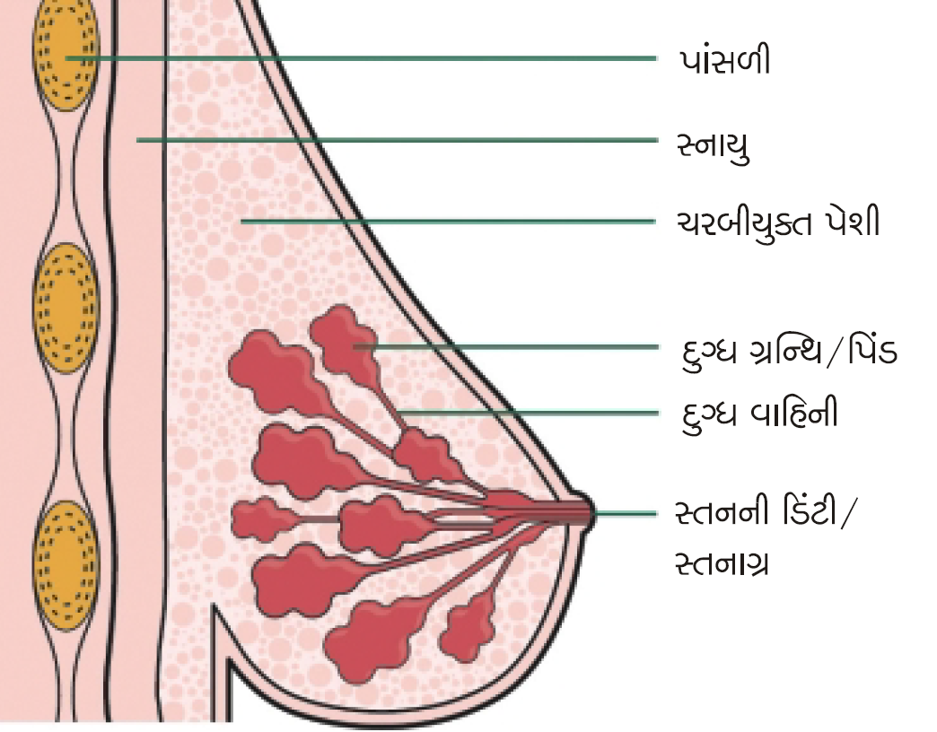
Ribs
Muscles
Fat cells
Milk gland
G=
Milk duct
Nipple

Slide 5
Risk Factors
Non-reversible risk factors for breast cancer :

Slide 6



Being female
Increasing age
Family History

Slide 7

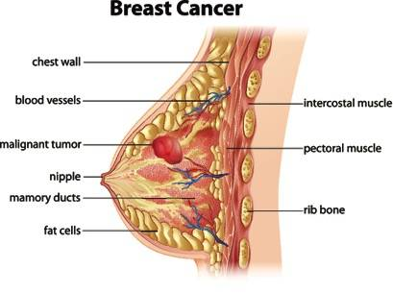
Menstrual history
Beginning your period at a younger age
Beginning menopause at an older age
Personal history of breast cancer

Slide 8
Reversible risk factors:

Slide 9


Have never been pregnant
Having your first child at an older age
Have never breast feed her child

Slide 10


Obesity
Stressful and irregular life
Drinking alcohol
Postmenopausal hormone therapy

Slide 11

How to avoid breast cancer
Exercise regularly
Maintain healthy weight

Slide 12



Breastfeeding the baby
Avoiding hormonal treatment
Limit the amount of alcohol and cigarettes

Slide 13
Symptoms

Slide 14


Changes in the size and shape of the breast
Lump in the armpit
Tumors in the breast

Slide 15
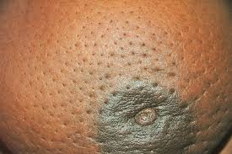
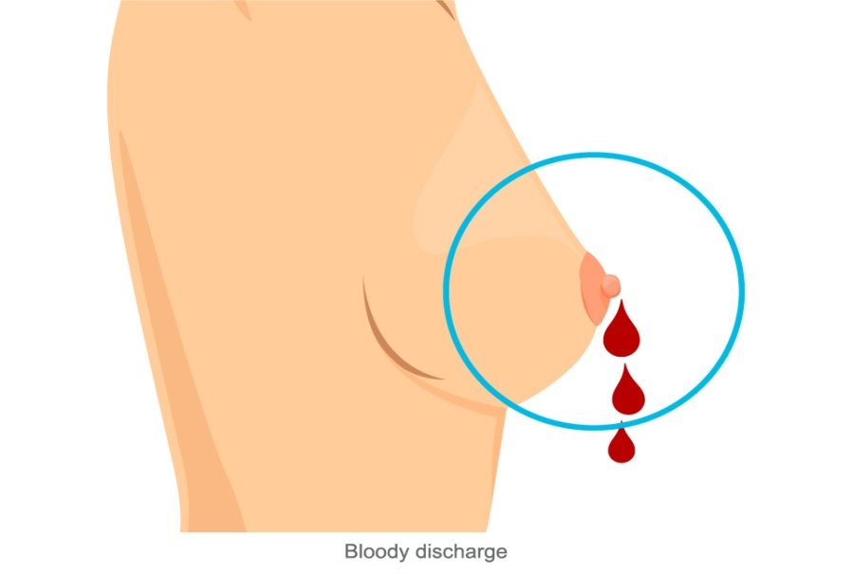

Redness or pitting of the skin over your breast, like the skin of an orange
Discharge from nipple
Inverted nipple

Slide 16
Early detection of breast cancer
Breast Self-examination
Mammogram

Slide 17
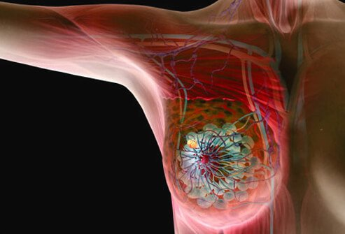

Slide 18





Breast Self-Examination
Step 1
Step 2
Step 3
Step 4
Step 5

Slide 19
What is mammography
A mammogram is an X-ray of the breast.
It’s a screening tool used to detect and diagnose breast cancer.
Mammogram along with sonogram gives accurate diagnosis for breast cancer.
Breast x-ray, mammogram and sonogram together known as mammosonogram.

Slide 20
